Slide 1
Aquatic Spatial Survey Design Process
Anthony (Tony) R. Olsen
Western Ecology Division
US Environmental Protection Agency
Corvallis, Oregon
Olsen.Tony@epa.gov
http://www.epa.gov/nheerl/arm

Slide 2
Spatial Survey Design Process
Site
Selection
using R
Design
File
Resource
Characteristics
Target
Population
Spatial
Survey
Design
Monitoring
Objectives
Design
Requirements
Institutional
Constraints
Sample
Frame
Notes:
Spatial survey design process involves three interrelated steps: (1) specifying the design requirements based on monitoring objectives, resource characteristics, target population, sample frame and institutional constraints, (2) selecting a spatial survey design that accomplishes the design requirements, and (3) selecting the sites based on the spatial survey design and the sample frame to produce the design file.

Slide 3
Monitoring Components Survey Design Survey Analysis
Monitoring objectives
Institutional constraints
Target population
Sample frame
Indicators and response design
Design requirements
Specification of survey design
Site selection
Site evaluation
Conduct field and lab measurements
Metric results database
Sample frame summary
Adjust survey weights based on implementation
Target population estimation
Report results

Slide 4
Specifying Design Requirements
Design requirements impacted by
Monitoring objectives
Aquatic resource characteristics
Target population and subpopulations
Sample frame
Institutional constraints
Iterative process involving professionals with different backgrounds and perspectives
Managers (decision makers)
Aquatic resource experts (ecologists, biologists, chemists, etc) with monitoring expertise
Statistical experts (experience in spatial survey design)
GIS specialists

Slide 5
Survey Design Key Components
Objectives stated precisely and quantitatively
Target population explicitly, precisely defined
Sampling frame constructed that represents the target population
Decision on which survey design meets needs
Selection of sites using survey design
Statistical analysis match survey design

Slide 6
Target Population: Lake Example
All lakes (and reservoirs) within the state of Yucatan
A lake is defined as a permanent body of water at least one hectare in surface area with a minimum of 1,000 sq m of open (unvegetated) water, and a maximum depth of one meter or more
Elements are individual lakes
Each lake is represented as a point (e.g. lake centroid)
Single value for each indicator obtained for each lake
Elements are all locations on surface area of lakes
Lakes are represented as polygons
Single value for each indicator obtained at locations within lakes

Slide 7
Target Population: Stream Examples
All streams and rivers within the state of Yucatan
A stream is defined as any stream or river channel that has flowing water during June-September
Elements are any location on the stream network (linear network)
Infinite number of locations
Single value for each indicator obtained for location
Elements are all predefined stream segments on the stream network (points)
Streams are represented as finite collection of segments using downstream endpoint as location
Single value for each indicator obtained for each segment

Slide 8
Target Population: Coastal Waters
All nearshore coastal waters on Gulf of Mexico within Mexico
Nearshore coastal waters is defined as
From head of salt to confluence with ocean
Estuaries and inland waterways
From mean high tide to 30m depth contour
Spatial units are any location within nearshore coastal waters

Slide 9
What is a Sample Frame?
A representation (usually a GIS layer) of the target population that is used to select the sample sites
It consists of sample units that are potential members of the sample
Extent (size) of the frame is obtained by summation
Almost always is not an exact representation of the target population
may not include some Target Population spatial units: under coverage
may contain non-target spatial units, e.g., mis-identified sample units: Over coverage
Notes:
When a survey design is used, a sample frame is critical for the site selection process.

Slide 10
Features in Space as GIS objects
Feature | Points | Lines | Polygons
Lakes | Individual lakes |  | Lake area
Streams | Segments | Linear network
Estuaries |  |  | Estuarine area
Wetlands | Depressional wetlands |  | Wetland area
Roads/trails |  | Linear network
Hydrologic Units | As points |  | As areas
Terrestrial Vegetation |  |  | As areas

Slide 11
Sampling Frame: Stream Target Populations
GIS coverage that includes all streams in the target population
National Hydrologic Data (NHD)
Quality of NHD as sampling frame
Under coverage: excludes some channels that appear on 1:24,000 USGS maps and not on maps
Over coverage: includes some channels/features that are not in stream target population
Survey design Limitations
Limited information available in NHD to help define design for domains
Other GIS coverages can add some attributes required

Slide 12
Sampling Frame: Lake Target Populations
GIS coverage of lakes and reservoirs
NHD; state lists
Lakes: two alternatives for elements
Each lake is element: lake viewed as a point
All points in all lakes are elements: area view
Quality of NHD as sampling frame
Under coverage: Excludes some lakes and reservoirs
Over coverage: Includes features that are not a lake or reservoir

Slide 13
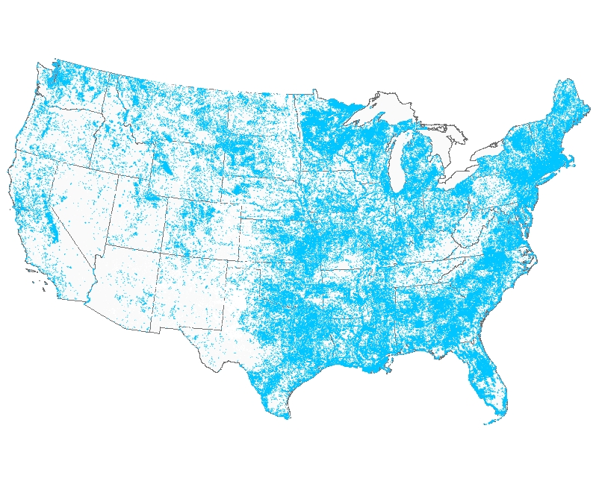
Lake Sample Frame: Sample Units are centroids of lakes/reservoirs

Slide 14
RF3 Sample Frame: Lakes

Slide 15
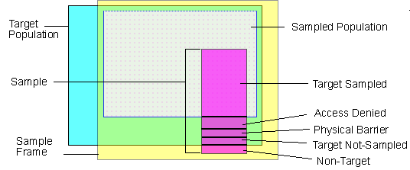
Target Population, Sample Frame, Sampled Population
We Live in an Imperfect World…
Ideally, cyan, yellow, gray squares would overlap completely
Notes:
Target population denotes the ecological resource about which estimates are needed
Defined conceptually using written text
Must be sufficiently specific so that it is clear if an aquatic resource is included or not.
Must define what are the elements of the target population. Elements may be any location in an estuary, a lake, any point on a stream network, or a 6th field Hydrologic unit
Sampling Frame is a physical representation of the target population
It consists of sample units that are potential members of the sample
Extent (size) of the frame is obtained by summation
Sample Frames almost always are not exact representations of the target population
Sample Frame may not include some Target Population elements: undercoverage
Sample Frame may contain non-target elements, e.g., mis-identified sample units: Overcoverage
A subset of the Sample Frame sample units are selected for sampling: the sample
Probability survey designs used to select the subset
One design: Generalized Random Tessellation Stratified Designs - GRTS
May include stratification, unequal probability selection, panels for surveys over time
Sample Frame overcoverage and sample site field access problems addressed by including an OversampleSampling Units are the Sites selected for sampling
Sampled Population is a conceptual population that is a subset of intersection the Target Population and the Sample Frame
It excludes portion of the Target Population within the Sample Frame that could not be sampled (conceptually) due to access problems, lost samples, or other reasons a sample could not be collected
It doesn't include part of the Sample Frame that is determined to not be elements of the Target Population
Population Estimates are based on All Sites Evaluated for potential field sampling
Site Evaluation and Field Sampling Categorizing each Sample Site is critical information
Target Sampled -- Site Information Collected
Landowner Denial -- Some landowners deny field crew access
Physical Barrier -- Site can not physically be reached within protocols or for safety reasons
Target Not-Sampled -- Sample lost, field season ended before site could be sampled, and many other reasons
Non-Target -- Site not element of target population
Population Extent estimates made for each Site Category
Provides estimate of the Target Population extent if it is not known
Provides estimate of the Sample Frame overcoverage extent, i.e., how much too large is Frame
Provides estimate of percent of Target Population that is expected to have landowners deny access
Population Status estimates based on Target Sampled Sites (e.g., IBI score, non- Impairment)
Potential Corrections and Assumptions
Non-Target Site Information can be used to determine if Sample Frame should be improved (mis-identified units, extent)
Estimates based on Target Sampled sites apply to the Sampled Population -- with no additional assumptions
Estimates based on Target Sampled sites can apply to the portion of Target Population within the Sample Frame ONLY IF assume that the Access Denied, Target Not-Sampled, etc., sites occurred randomly and independently of site characteristics
Estimates for Target Population NOT ONLY require assumptions above BUT ALSO that portions of Target Population that are not included in the Sample Frame have same characteristics as the Sampled Population

Slide 16
Selecting a Specific Spatial Survey Design
An art and a science
Depends on availability and quality of a sample frame
Depends on design requirements
Basic choices are GRTS or IRS designs that are
Non-stratified equal probability
Non-stratified unequal probability
Stratified equal probability
Stratified unequal probability

Slide 17
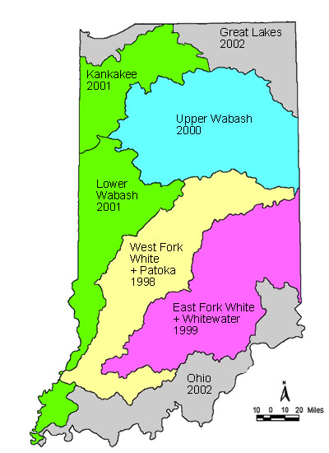
Indiana Stream Example
Objective: Estimate proportion of wadeable perennial stream length within Upper Wabash basin that are impaired and non-impaired for aquatic life use using benthic macroinvertebrate index and a quality habitat evaluation index
Target population: All wadeable perennial streams during summer index period within Upper Wabash
Sample frame: All USGS National Hydrologic Data (NHD) perennial coded streams within Upper Wabash basin

Slide 18
Indiana Stream Example Survey Design Survey Analysis
Sample size: 50 sites with equal number in 1st, 2nd, 3rd, and 4th+ Strahler order
Survey Design: GRTS for a linear network (spatially-balanced random sample)
Oversample: 50 sites
Site Evaluation
TS: Target Sampled
NT: Non-target
LD: Landowner denied access
PB: Physically barrier
Adjust weights
Estimate perennial stream extent
Estimate stream km impaired

Slide 19
Indiana Upper Wabash Basin: Perennial Stream Length (km)
Stream Length Category | Length (km) | Percent Total
NHD GIS coverage | 7358 | 100
Estimated perennial | 5707 ± 724 | 77.6 ± 9.8
Estimated sampled | 3414 ± 729 | 46.4 ± 9.9

Slide 20
Indiana Upper Wabash Basin: Biological and Habitat Assessment
Indicator | Status | Length (km) | Percent Total
IBI | Not Impaired | 4128 ± 1134 | 72.3 ± 13.0
 | Impaired | 1579 ± 810 | 27.7 ± 13.0
 | Total | 5707 | 100
QHEI | Not Impaired | 3373 ± 990 | 59.1 ± 16.3
 | Impaired | 2334 ± 1168 | 40.9 ± 16.3
 | Total | 5707 | 100

Slide 21
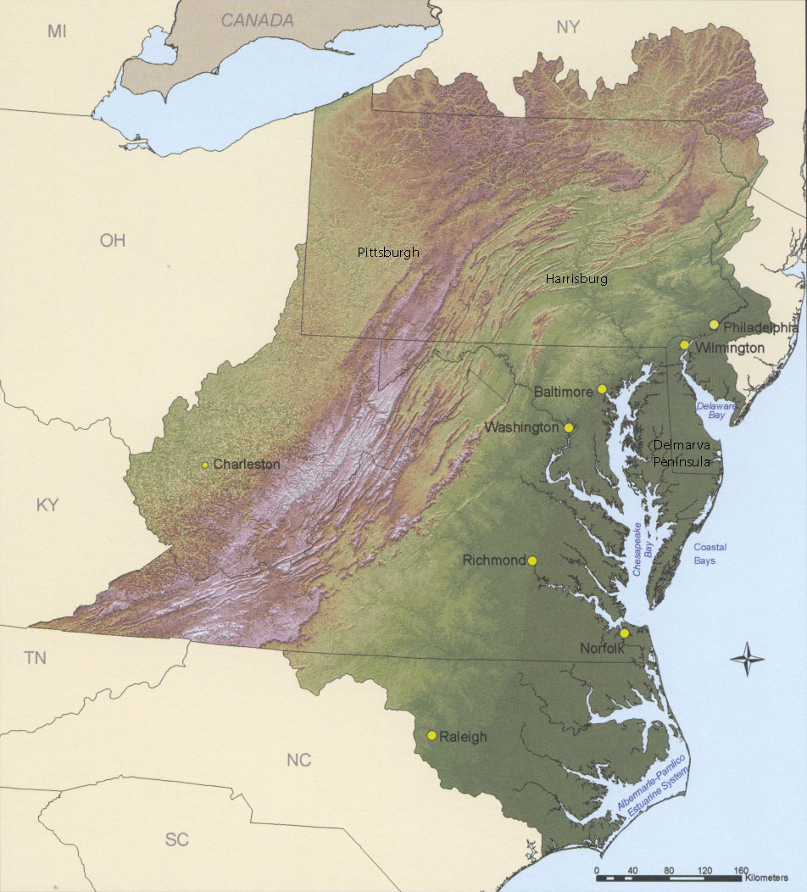
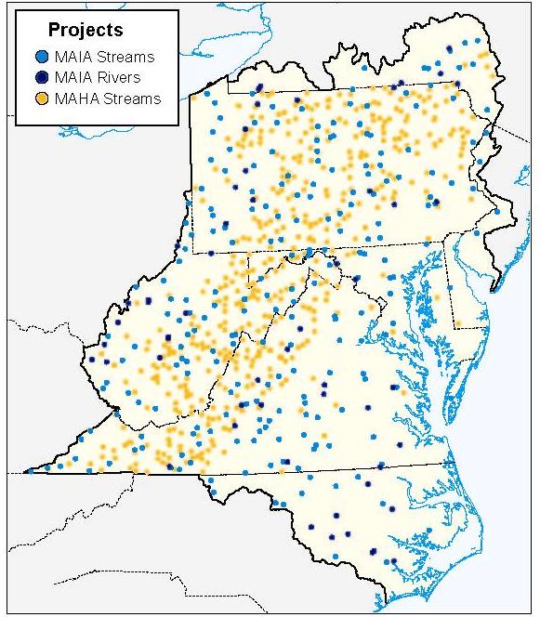
Mid-Atlantic Integrated Assessment (MAIA) Streams and Rivers

Slide 22
Mid-Atlantic Integrated Assessment Streams and Rivers
Biological Assemblage: | Proportion of Stream Resource in Poor Condition | Primary Stressors*
Fish | 31% | Non-native fish Lack of large wood
Macroinvertebrates | 41% | Excess fine sediments Acidity
Algae | 33% | Nutrients Excess fine sediments
* based on combination of high relative extent and high relative risk to assemblage

Slide 23
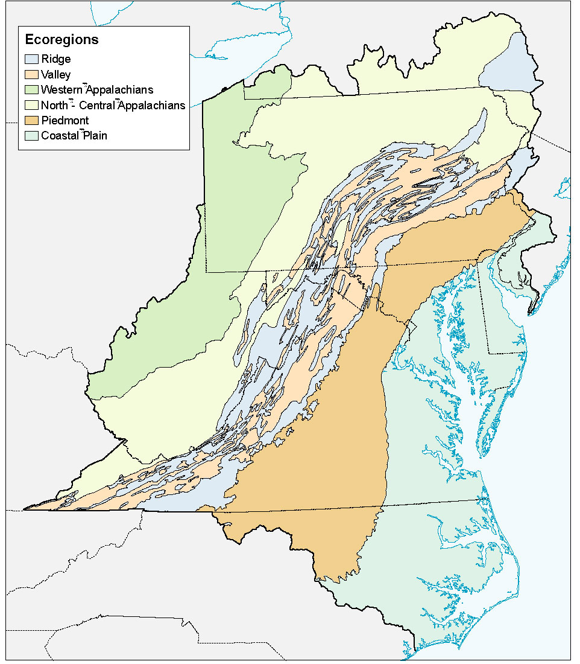
MAIA Ecoregions: Omernik Level III

Slide 24
Mid-Atlantic Integrated Assessment: Assessment by Ecoregion
Ecological Region: | Summary of Condition | Biological Assemblage Most at Risk (% of stream length in poor condition) | Primary Stressors*
Coastal Plain | Relatively Poor | Macroinvertebrates (88%) | Excess sediments Non-native fish
Piedmont | Intermediate | Macroinvertebrates (42%) | Non-native fish Nutrients
Valleys | Intermediate | Macroinvertebrates (45%) | Non-native fish Nutrients
Ridges | Relatively Good | Fish (26%) | Non-native fish Lack of large wood
North and Central Appalachians | Relatively Good | Fish (40%) | Non-native fish Lack of large wood
Western Appalachians | Relatively Poor | Algae (51%) | Excess sediment Lack of large wood

Slide 25
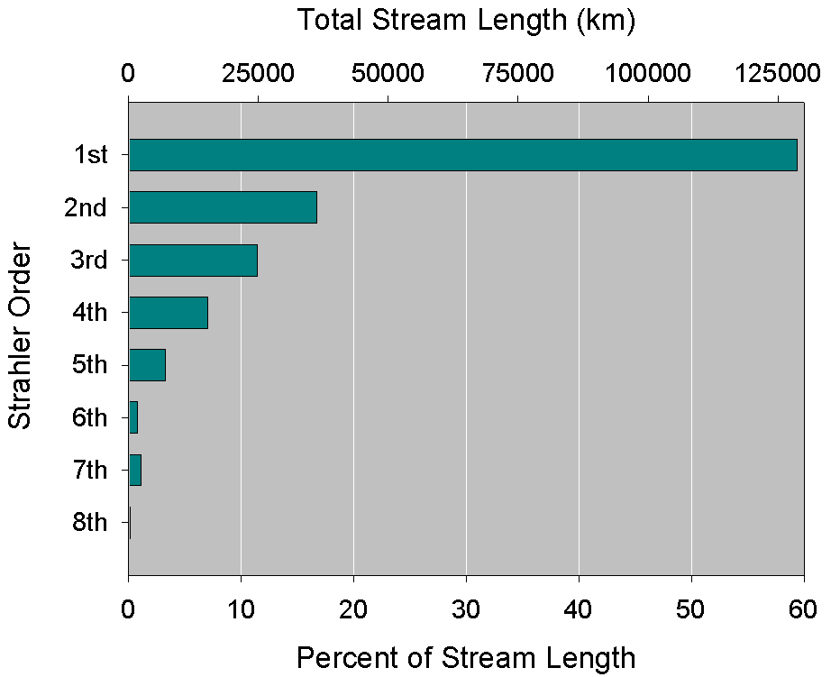
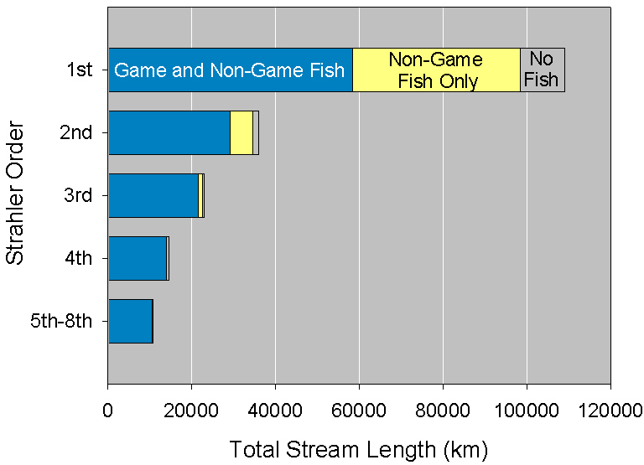
MAIA: Description of Extent
Presence Game, Non-Game, No Fish

Slide 26
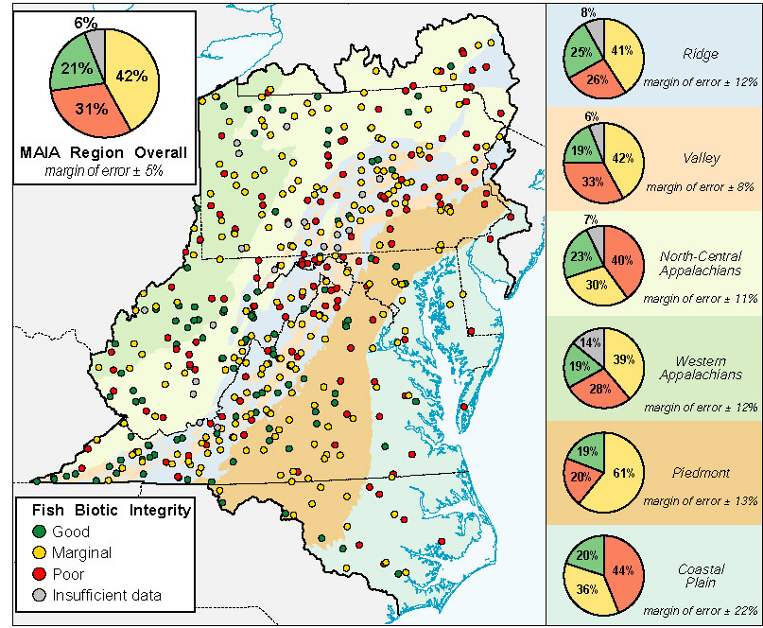
MAIA: Fish Assemblage Condition

Slide 27
MAIA: Fish, Macro-invertebrate and Algal IBI results
Region | % in Good Condition |  |  | % in Poor Condition
 | Fish | Macro-invertebrates | Algae | Fish | Macro-invertebrates | Algae
Mid-Atlantic Region | 21 | 26 | 31 | 31 | 41 | 33
Coastal Plain | 20 | 0 | 35 | 43 | 88 | 41
Piedmont | 20 | 20 | 27 | 20 | 42 | 37
Valleys | 19 | 26 | 25 | 33 | 45 | 34
Ridges | 26 | 49 | 42 | 26 | 20 | 21
North and Central Appalachians | 23 | 40 | 45 | 40 | 28 | 19
Western Appalachians | 19 | 13 | 8 | 28 | 46 | 51

Slide 28
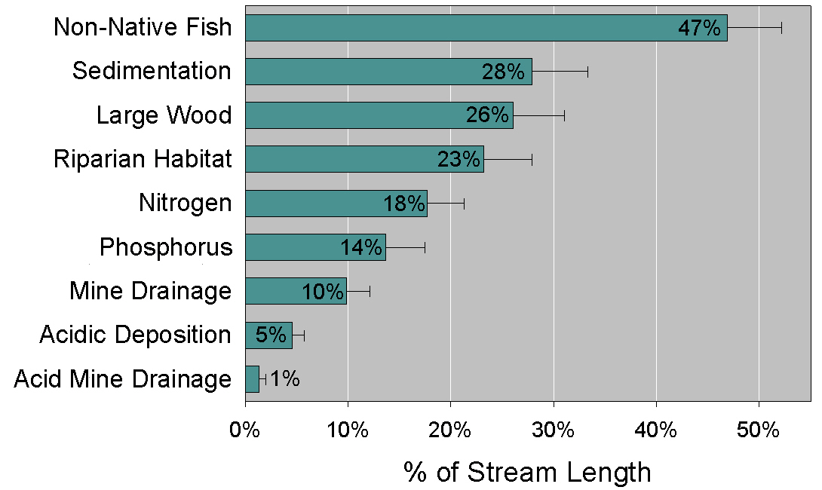
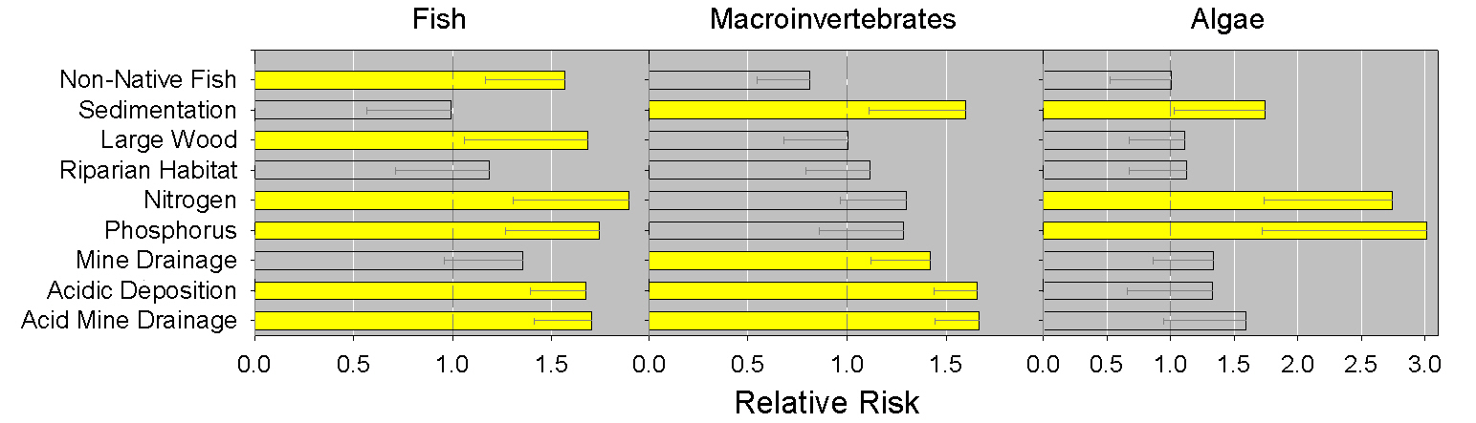
MAIA: Extent of Stressor Presence & Relative Risks

Slide 29
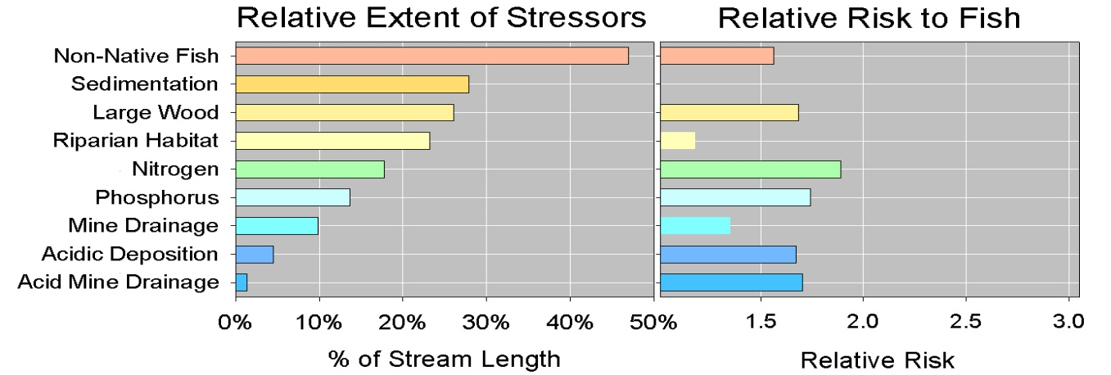
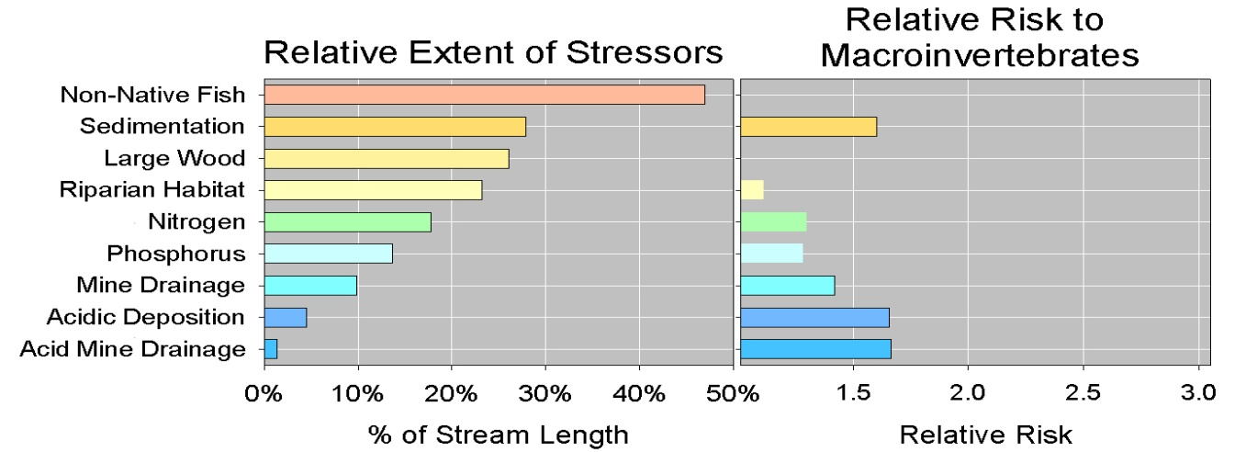
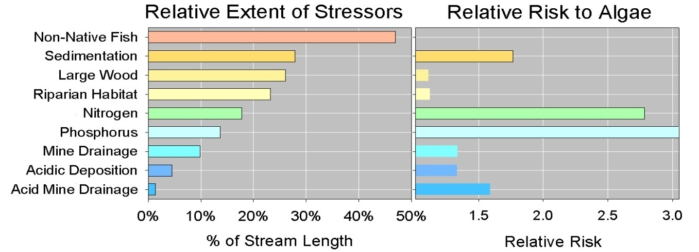
MAIA: Relative Risk Assessment
“The risk of Poor BMI is 1.6 times
greater in streams with Poor SED
than in streams with OK SED.”

